Slide 1
What is Generics in JAVA
The idea is to allow type (Integer, String, … etc and user defined types) to be a parameter to methods, classes and interfaces. For example, classes like HashSet, ArrayList, HashMap, etc use generics very well. We can use them for any type.
Generics has got many benefits over non-generic code.
Code Reuse: We can write a method/class/interface once and use for any type we want.
- Type Safety : Generics make errors to appear compile time than at run time (It’s always better to know problems in your code at compile time rather than making your code fail at run time). Suppose you want to create an ArrayList that store name of students and if by mistake programmer adds an integer object instead of string, compiler allows it. But, when we retrieve this data from ArrayList, it causes problems at runtime.

Slide 2
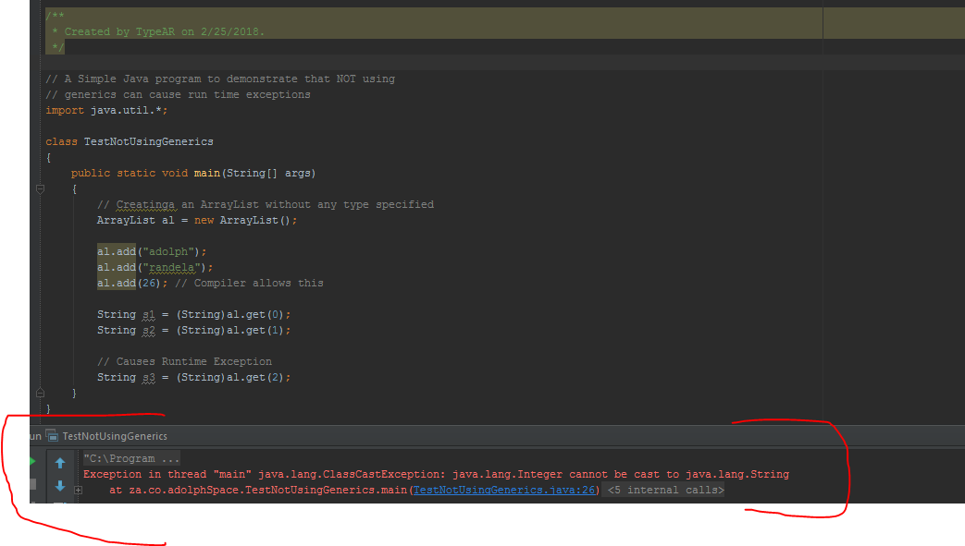
A Simple Java program to demonstrate that NOT using Generics cause run times exception

Slide 3
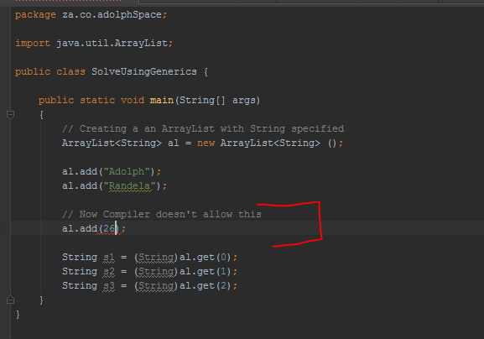
How generics solve this problem?

Slide 4
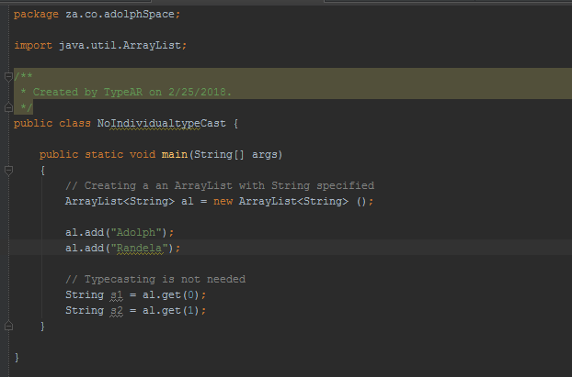
Individual Typecasting is not needed?

